Slide 1
The
Universal
Process
Orchestrator
Orchestrate. Automate. Transform.

Slide 2



Content
About SURGE
Success Story
CaseStudy
Demonstration
Camunda Open Source Vs Enterprise Editions
Q&A
Notes:
#1 Agenda Slide
#2a Slide - What is Caterpillar Business challenge (Krishna to fill it up) We need a solution where IT and business to collaborate, which is scalable and resilient
#2b Slide - Why Camunda Solution Camunda help orchestrate multiple endpoints Developer friendly Open Architecture End-to-end orchestration standards-based collaboration Business and IT can collaborate Solution can be scalable and resilient
#3 Slide - Camunda orchestrate, Automation, Transform
#4 - Comparision between Camunda SaaS and Self-Managed (need to discuss with Krishna on removing the optimizer from the free version list) - completed

Slide 3


^{What we need?}
^{Caterpillar Challenges!}
Bring IT and the business together
Make business Processes agile & configrable to suit business demands
Get unparalleled speed, scale and resilience.
^{Why CAMUNDA?}
We have more than five endpoints needed for automation.
Business and IT teams struggle to communicate ^{and collaborate.}
Digital transformation leads to a growing need for scalability and resilience.
^{End-to-End Orchestration}
^{Standards-based}
^{Collaboration}
^{Developer-Friendly}
^{Open Architecture}
^{Cost-Effective}

Slide 4
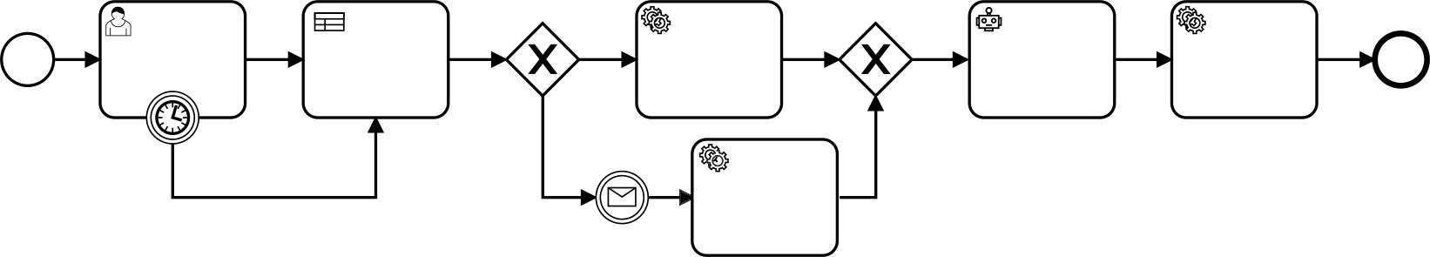

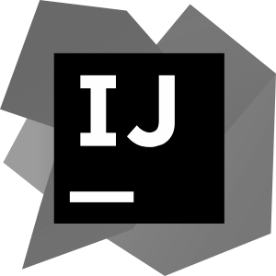

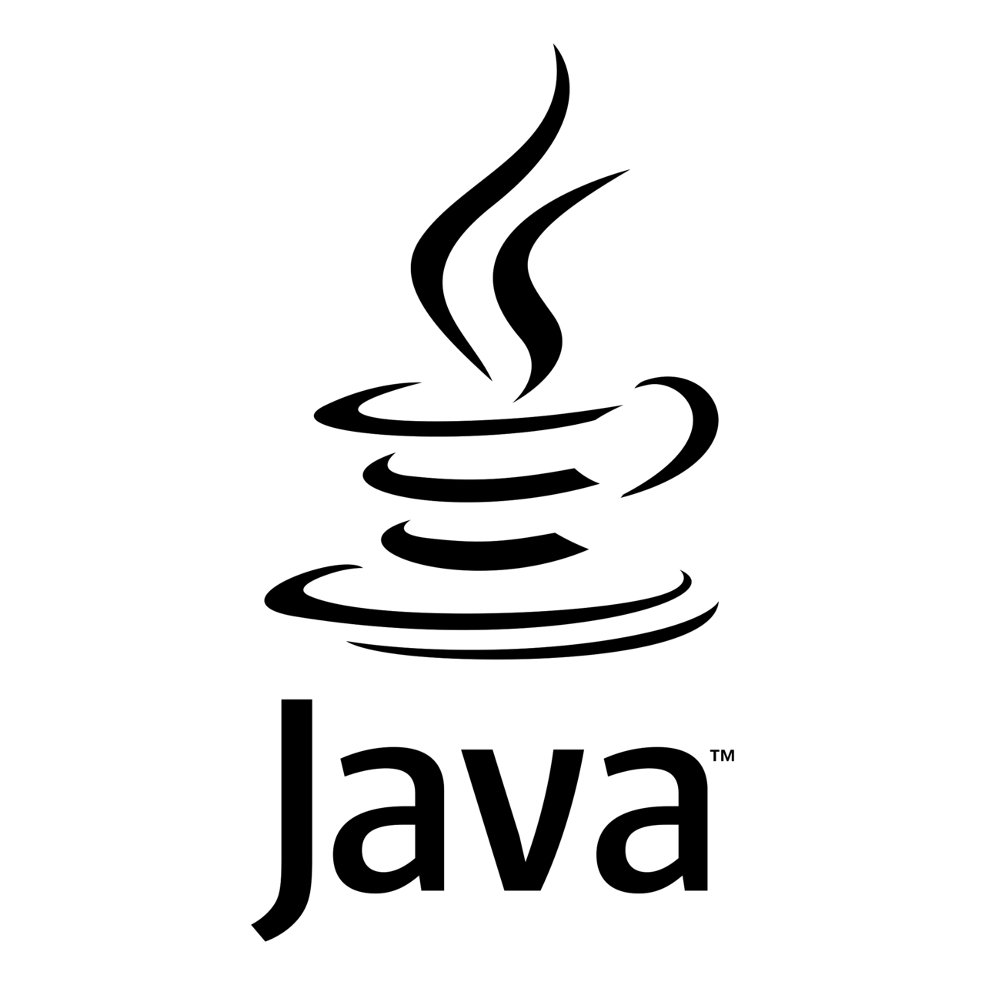
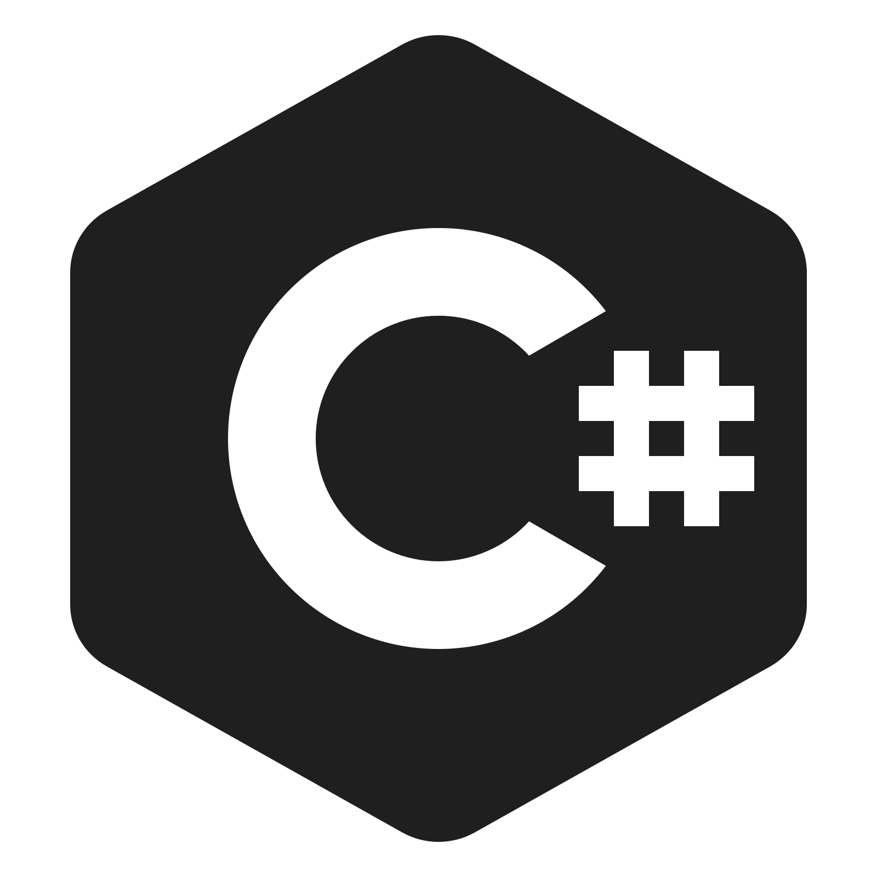

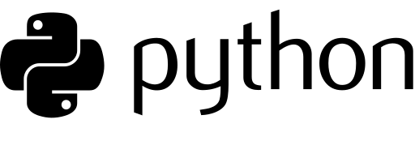



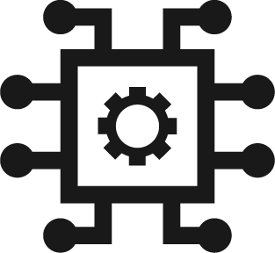





Camunda Solution
Orchestrate
Automate
Transform
Complex process flows across people, systems and devices.
Any process, anywhere.
Your organization toward a digital future.
Collaborate
Flexibility
All Endpoints
Human Work
AI
Business Rules
Micro Services
RPA
API
IoT
Systems (legacy + homegrown)

Slide 5
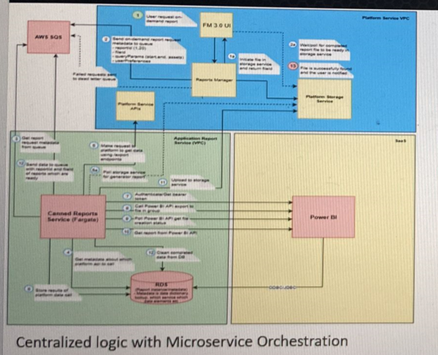
Canned Report Architecture Diagram
Benefits
Bring IT and the business together
Make business Processes agile & configrable to suit business demands
Get unparalleled speed, scale and resilience.

Slide 6
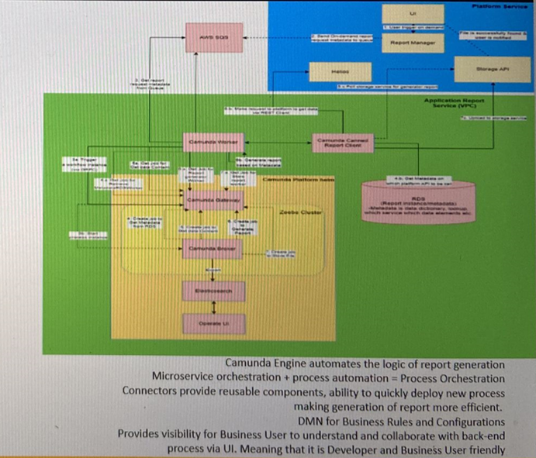
Camunda Architecture Diagram
Benefits
Bring IT and the business together
Make business Processes agile & configrable to suit business demands
Get unparalleled speed, scale and resilience.

Slide 7
Prepare Elastic Search Index
Get Asset Reference Worker
Download Asset Usage Single Asset Code Data Set
Merge Data Set
Prepare File in Platform Cloud Data Storage
Fetch Report Template Configurations
Write to File in Platform Cloud Data Storage
CAMUNDA
SOLUTION
DEMO
Asset
Management
Report
7

Slide 8
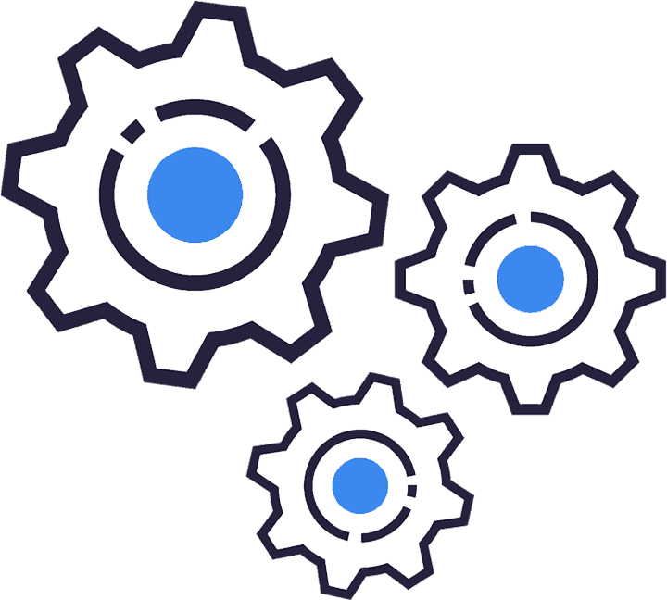
Case Study – Asset Management Report
Design, Development & Effort
40% of logic has been moved as reusable components (Connectors) which can be used across the reports & developers has the flexibility to drag & drop the connectors while designing the process
Report data download
Data Merging Component
Report generation based on template
Data upload to storage
10% of the static business key attributes are moved into configurable business rules (DMN) & Business users has the flexibility to update the business rules
Template configurations
Service end points
Request attributes to download the data
Attributes for report sections
Total effort <30 hours until developer unit testing
8

Slide 9
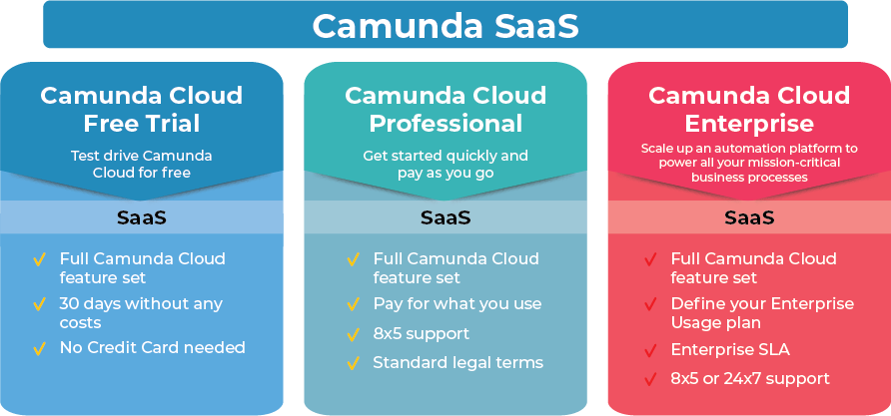
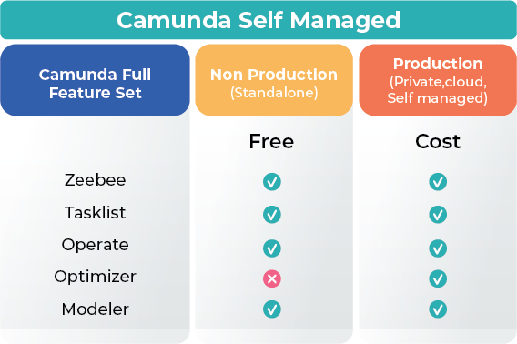
Camunda Open Source Vs Enterprise Editions
Zeebe
Next-generation, cloud-native workflow engine that unlocks unparalleled speed, scale & resilience. Open source SDKs in your preferred programming language brings the extensibility you need for your complex business processes.
Tasklist
Assign and execute tasks that require human interaction via easy-to-use Forms or via your own apps with the Tasklist API.
Operate
Real time visibility to monitor, analyze and resolve problems with any process instance.
Optimize
Get the insights you need to understand and continuously improve your business processes.
Modeler
Model & deploy business process diagrams with BPMN & DMN.
Available via web and desktop app.
9

Slide 10
Q&A
10

Slide 11

Thank You

Slide 12
Camunda Platform: The Universal Process Orchestrator
Design
Automate
Improve
Developers & business users collaborate to design, connect & deploy processes with Camunda.
Enterprise-grade automation platform. Built for today’s business complexity, loved by developers.
Teams have the insights to fix the highest ROI problems for their business processes.
Modeler
Model & deploy business process diagrams with BPMN & DMN.
Available via web and desktop app.
Zeebe
Next-generation, cloud-native workflow engine that unlocks unparalleled speed, scale & resilience. Open source SDKs in your preferred programming language brings the extensibility you need for your complex business processes.
Optimize
Get the insights you need to understand and continuously improve your business processes.
Tasklist
Assign and execute tasks that require human interaction via easy-to-use Forms or via your own apps with the Tasklist API.
Connectors
Integration Framework
Forms
Operate
Real time visibility to monitor, analyze and resolve problems with any process instance.
Out-of-the-box integrations to easily communicate with popular enterprise applications & protocols.
Build & provision your own connectors to any system including homegrown & legacy applications.
Drag & drop creation of forms that power workflows that require human interaction.
Notes:
We think about process orchestration in terms of a lifecycle that supports continuous improvement
[CLICK] Starting with tools that help software developers and business users collaborate to design processes
Teams use our Modeler tool to build processes using the BPMN standard and implement decision automation using the DMN standard
Modeler is also where you’ll find out-of-the-box connectors, and where you can create your own reusable connectors
And you can use Modeler to quickly build user task forms for workflows that require human interaction
[CLICK] Once teams have collaboratively designed processes, you can start automating them in a high-performance way
Our next-generation workflow engine, Zeebe, is designed for speed, scale, and resilience; which means your processes will be both fast and reliable
We also offer an application called Tasklist, for tasks that require human interaction, which is essential for business processes that can’t be or shouldn’t be fully automated
And we provide a powerful process manager called Operate, which provides real-time visibility into running processes and tools to troubleshoot incidents
[CLICK] Finally, once you have processes running, Optimize uses your actual process data to provide comprehensive analytics…
[CLICK] … that guide you toward continuous improvement of your process’ performance

Slide 13
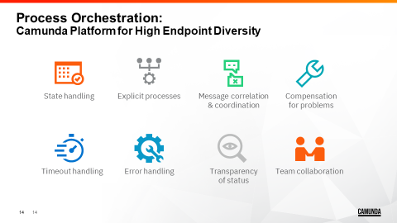

Slide 14
Camunda Advantage
Traditional Approach
Camunda Approach
Fragmented Processes
End-to-End Orchestration
Proprietary
Standards-based Collaboration
Tough to Install & Extend
Developer-Friendly
Blackbox Monoliths
Open Architecture
Endless Expense & Maintenance
Cost-Effective
Notes:
We believe our approach to process automation will increase your agility, help you create amazing customer experiences, and support you as you integrate with legacy systems
With Camunda, you can transform fragmented business processes into processes that are orchestrated from end to end, that are fully endpoint-agnostic, and that can be easily replicated for horizontal scalability or even fully replaced on the fly
We support the use of open standards to bring software developers together with everyone else in the organization who has a stake in the business process
The way we prioritize developers is unique, and we’ve found that it helps organizations automate their processes in an iterative way, which empowers developers and ultimately makes them happier and more productive
Our software is both fully integrated and consists of loosely coupled components that you can integrate with any IT tooling or technical architecture that you have in place
All of this leads to a lower total cost of ownership with Camunda; that’s lower costs in terms of licensing, speed of implementation, consulting fees, and day-to-day operational costs

Slide 15

Camunda Platform: The Universal Process Orchestrator
Design
Automate
Improve
Developers & business users collaborate to design, connect & deploy processes with Camunda.
Enterprise-grade automation platform. Built for today’s business complexity, loved by developers.
Teams have the insights to fix the highest ROI problems for their business processes.
Modeler
Model & deploy business process diagrams with BPMN & DMN.
Available via web and desktop app.
Zeebe
Next-generation, cloud-native workflow engine that unlocks unparalleled speed, scale & resilience. Open source SDKs in your preferred programming language brings the extensibility you need for your complex business processes.
Optimize
Get the insights you need to understand and continuously improve your business processes.
Tasklist
Assign and execute tasks that require human interaction via easy-to-use Forms or via your own apps with the Tasklist API.
Connectors
Integration Framework
Forms
Operate
Real time visibility to monitor, analyze and resolve problems with any process instance.
Out-of-the-box integrations to easily communicate with popular enterprise applications & protocols.
Build & provision your own connectors to any system including homegrown & legacy applications.
Drag & drop creation of forms that power workflows that require human interaction.
Notes:
We think about process orchestration in terms of a lifecycle that supports continuous improvement
[CLICK] Starting with tools that help software developers and business users collaborate to design processes
Teams use our Modeler tool to build processes using the BPMN standard and implement decision automation using the DMN standard
Modeler is also where you’ll find out-of-the-box connectors, and where you can create your own reusable connectors
And you can use Modeler to quickly build user task forms for workflows that require human interaction
[CLICK] Once teams have collaboratively designed processes, you can start automating them in a high-performance way
Our next-generation workflow engine, Zeebe, is designed for speed, scale, and resilience; which means your processes will be both fast and reliable
We also offer an application called Tasklist, for tasks that require human interaction, which is essential for business processes that can’t be or shouldn’t be fully automated
And we provide a powerful process manager called Operate, which provides real-time visibility into running processes and tools to troubleshoot incidents
[CLICK] Finally, once you have processes running, Optimize uses your actual process data to provide comprehensive analytics…
[CLICK] … that guide you toward continuous improvement of your process’ performance

Slide 16
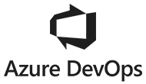



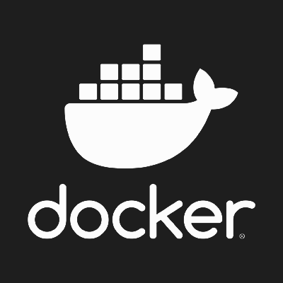

Code + deploy in your preferred language and tooling.
Run on your preferred platforms.
Across all endpoints.
Human Work
AI
Business Rules
Microservices
RPA
API
IoT
Systems (legacy + homegrown)
Notes:
We call our approach to process orchestration “universal” because we can orchestrate business processes, from start to finish, across a wide variety of endpoints
That includes everything from your legacy systems, to your next-generation microservices, plus your RPA bots, Internet of Things devices, and manual tasks
Because business processes are complex, we believe it’s critical to enable software developers and other IT users to deliver process automation projects by writing code in any programming language, working in their preferred IDE, using their existing CI/CD pipelines, and deploying to a variety of platforms – whether on premises or in the public, private, or hybrid cloud
Note: The icons on this slide represent the following technologies:
Java, Ruby, VSCode, IntelliJ, Azure DevOps, C#, Python, Eclipse, JUnit, Jenkins
Kubernetes, On Prem / Self-Managed, Cloud, Docker

Slide 17
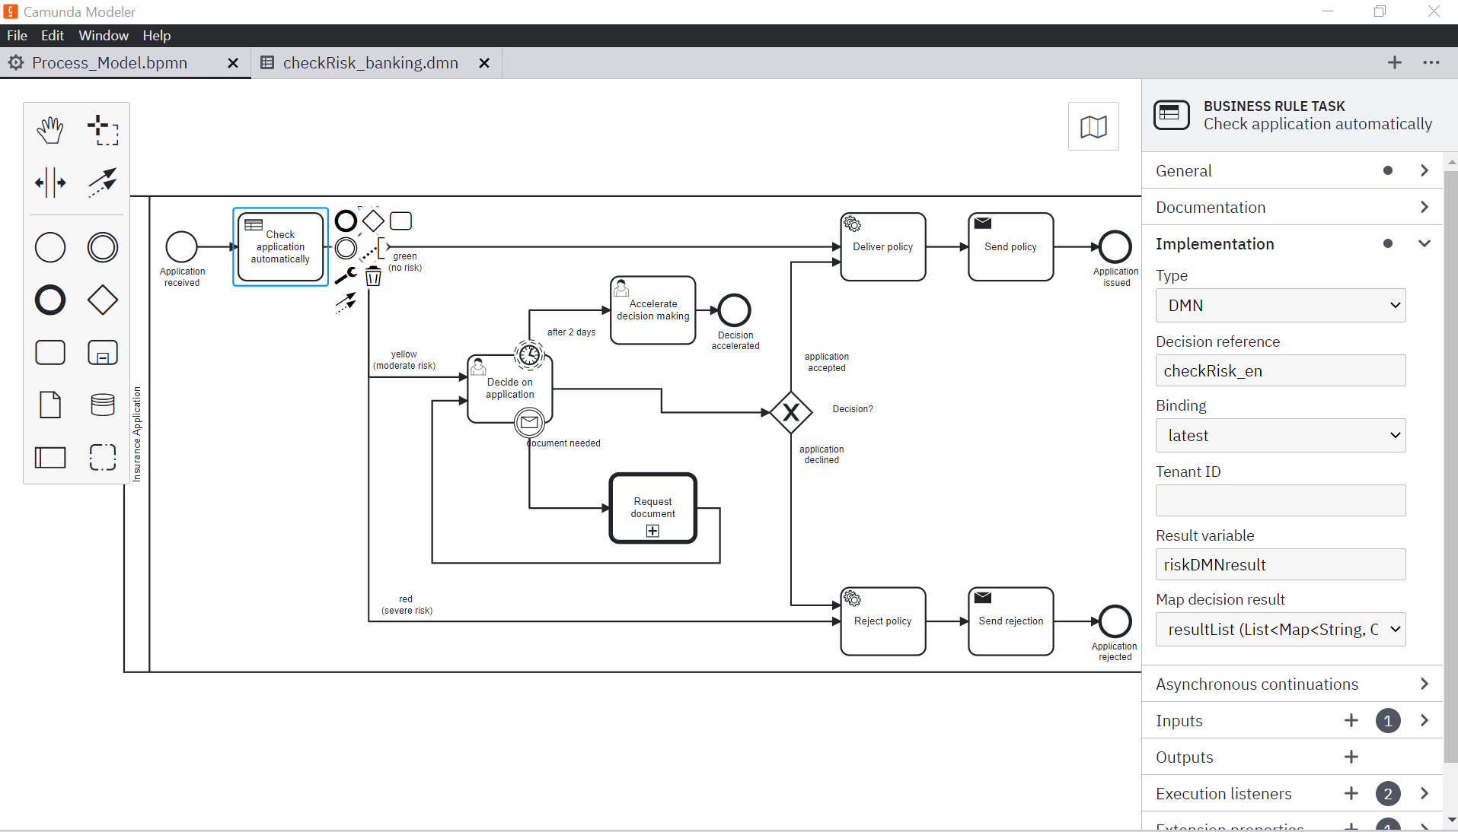
Simplified
Process Orchestration
Process Automation
+
Microservices Orchestration
Human Work
Business Rules
Microservices
AI
RPA
API
IoT

Slide 18
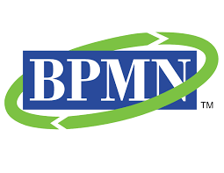
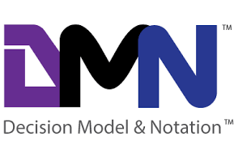
Benefits..
Standards-Based
Developer-Friendly
Flexibly-Deployed
Standard-based process and decision modeling
Lightweight engine (Headless)
Open architecture
APIs & Connectors
Combined with preferred tools (e.g., Docker, OpenShift, Kubernetes, Kafka) and development frameworks without disrupting existing CI/CD
Loosely coupled components easily integrated with any technical architecture or framework
Invocation for components, services, activities, functions
Synchronous and Asynchronous sequences across all endpoints
Private cloud, public cloud, and on-premise deployments
BPMN
DMN
Standards to more effectively collaborate across process design and rules management with built-in process execution, operational management, and continuous improvement

